Slide 1
Aspiration Challenge Growth
@swr_school

Slide 2
GCSE Mathematics
Edexcel 9-1
Aspiration Challenge Growth
@swr_school

Slide 3
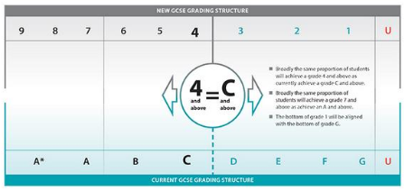
GCSE Maths has changed!
New grading 1-9.
Higher tier paper from grade 9-4, Foundation from 5-1.
Far more problem solving questions.
3 papers, one non calculator, two calculator.
Grade boundaries will remain unknown until after the results are in

Slide 4
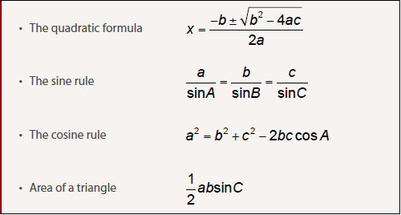
GCSE formulae

Slide 5
New content
At higher and foundation
Venn diagrams
Know exact values for sin, cos and tan at 30, 45 and 60 degrees
Work with percentages greater than 100%
New to higher tier
Equations of circles
Find gradients at points on curves
Iteration

Slide 6
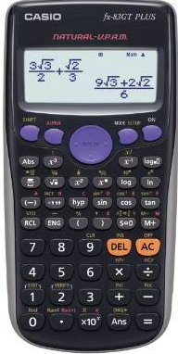
What we expect from students.
Bring the correct equipment (pen, pencil, ruler, scientific calculator, protractor and compasses).
Complete homework.
Try in lessons and be prepared to get it wrong.
Revise regularly at home.

Slide 7
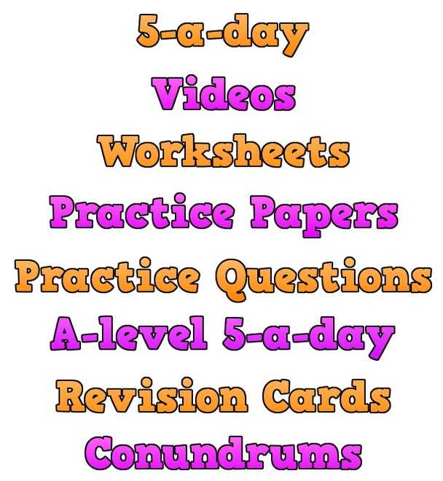
Where to go for help
Corbettmaths.com (5 a day, videos, worksheets).
CGP revision guides.
Thursday after school maths club.
Edexcel.com
BBC bitesize (2015 onwards).
Youtube.
Previous in school assessments.

Slide 8
AQA GCSE English Language and Literature
Supporting your child with the new GCSE
Aspiration Challenge Growth
@swr_school

Slide 9
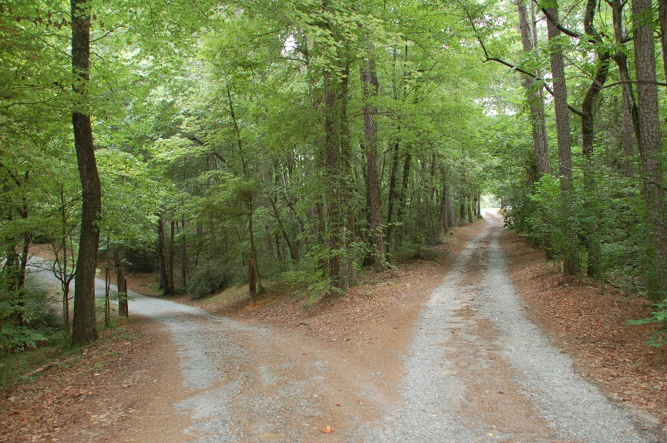
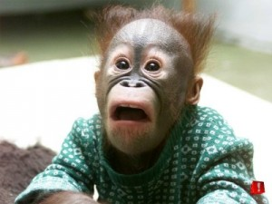
Thinking back to last year
The path ahead has changed
Don’t panic!

Slide 10
Understanding the Courses
Some major changes from the past
No Coursework – Entirely exam based
No ‘Of Mice and Men’ or ‘To Kill a Mockingbird’
No separate tiers of entry

Slide 11
2 GCSES
Spoken Language Endorsement
A presentation to the class on a topic of their choice.
With questions and feedback
PASS
MERIT
DISTINCTION
English Language:
2 Exam papers in June of Year 11 -
Paper 1 - Fiction Reading and Writing
Paper 2 – Non fiction Reading and Writing (Including texts from 19th Century)
English Literature
2 Exams
Paper 1 - Shakespeare and a Nineteenth century novel
Paper 2 - Modern Novel/Play and Poetry

Slide 12
Focus for September - December
How to support:
Keep a track of current topic and ask about it.
Remind students to complete homework to a good standard
Help them organise their work
Getting to know the Assessment Criteria
Studying our first text – Modern Play –
An Inspector Calls – JB Priestley
Developing our own writing skills
Writing to argue
Using sentences for effect

Slide 13
Writing - What is needed?
What can help?
Proof reading in all subjects
Grammar practice with online apps
Reading of a wide range of texts
Always insisting on the basics!
Greater Emphasis on technical accuracy – 20% of marks in the English language exams
Sentences control and variation
Punctuation – a range
Vocabulary – ambitious
Paragraphing
Organisation of piece
Spelling
PURPOSE
AUDIENCE

Slide 14
THE 5 READING SKILLS
IDENTIFY - Key ideas/ quotes
ANALYSE – What is the effect of language/ structure here?
COMPARE – How are these two texts similar or different?
CONTEXTUALISE – What has affected the way this text was written?
EVALUATE – How do I feel about this text and why?

Slide 15
How can you help with developing reading skills?
Encourage wider reading -(novels, newspapers, magazines, non fiction texts etc.)
Ask questions about wider reading
Check homework is completed – 1 sentence is not a developed answer!

Slide 16
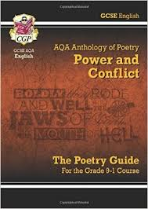
Other ways of supporting
Encourage use of online revision sites – Spark notes for GCSE Literature texts
Encourage use of GCSE Bitesize for English skills
Use apps
Buy revision guides on set texts – York Notes are particularly good.
CGP Revision guide on Poetry cluster £3.00

Slide 17
Science
Aspiration Challenge Growth
@swr_school

Slide 18
AQA GCSE Combined Science: Trilogy
Two year course leading to 2 GCSEs by the end of year 11
Topics in biology, chemistry, physics
Six exams, each of 75 minutes, two in each of the 3 science subjects, available at foundation and higher tier
Each exam carries equal weight
100% terminal assessment
No controlled assessment or coursework

Slide 19
Triple Award
Three GCSEs in two years – Biology, Chemistry, Physics
Taught in 15 periods per cycle, 5 for each subject
Three specialist teachers
Each GCSE assessed in two, 105 minute exams, each representing 50% of final mark
Exams available at foundation and higher tier
No controlled assessment or coursework

Slide 20
Assessing Practical Work
No coursework or controlled assessment
Required practical activities throughout the course
Knowledge and skills acquired in required practical activities will be assessed in exams alongside all other content
Experience of each required practical activity will be assumed by the exam board, so good attendance is essential

Slide 21
Additional Support
Revision guides
Work books
Kerboodle
Apps
Lunchtime drop-ins
Revision classes

Slide 22
Careers Information at SWR

Slide 23
Useful Websites
School registered website:
eCLIPS GL8 8AE
Public Websites
icould - Bing
National Careers Service.
Notes:
23

Slide 24
Careers @SWR

Slide 25
Post 16 open events.
Stroud Berkley Green | 17/9/16 | 10-1pm
SGS Stroud Campus | 1/10/16 | 10-1pm
Malmesbury School | 3/10/16 | 7-8.45
Cirencester College | 15/10/16 | 10-3pm
Stroud Ambitions Stratford Park Leisure Centre | 9/11/16 | 4.30-8.30pm
SHS/Marling | 10/11/16 | 5-8
KLB | 16/11/16 | 7-9
Archway | 17/11/16 | tbc
Rednock | 17/11/16 | 5.30-8.30
St Peters School Gloucester | 30/11/16 | tbc
Sir Thomas Riches School Gloucester | 31/1/17 | 6.30-8.30

